Slide 1

AMAZON SALES DATA ANALYSIS
MEGHA PATIL

Slide 2
PROJECT DETAIL
Project Title | Analyzing Amazon Sales data
Technologies | Data Science
Domain | E-commerce
Project Difficulties level | Advanced
PROBLEM STATEMENT
Sales management has gained importance to meet increasing competition and the need for improved methods of distribution to reduce cost and to increase profits. Sales management today is the most important function in a commercial and business enterprise.
Perform ETL: Extract-Transform-Load some Amazon dataset and find for me Sales-trend -> month-wise, year-wise, yearly month-wise
Find key metrics and factors and show the meaningful relationships between attributes.

Slide 3
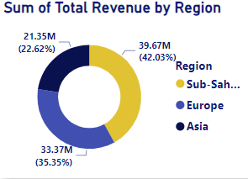
QUICK INSIGHT
A quick insight for 2010 to 2017 amazon sales.
REVENUE CATEGORIZED BY TOP 3 REGION

Slide 4
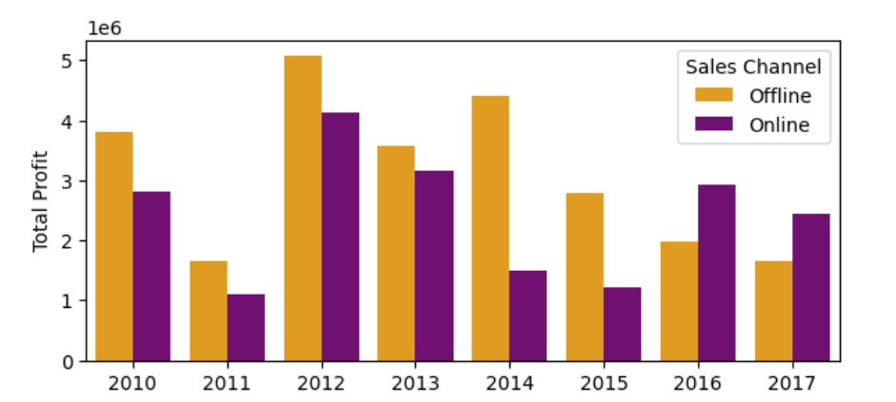
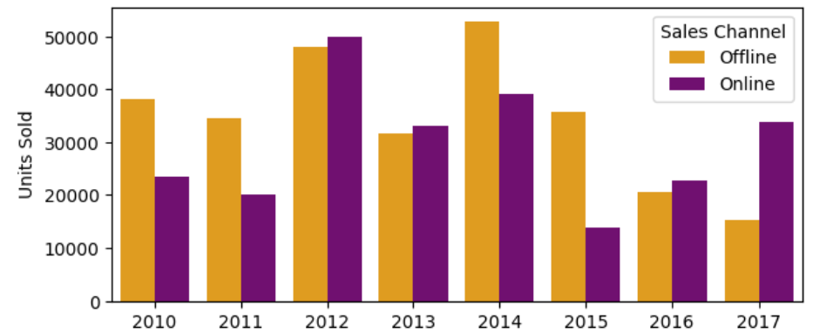
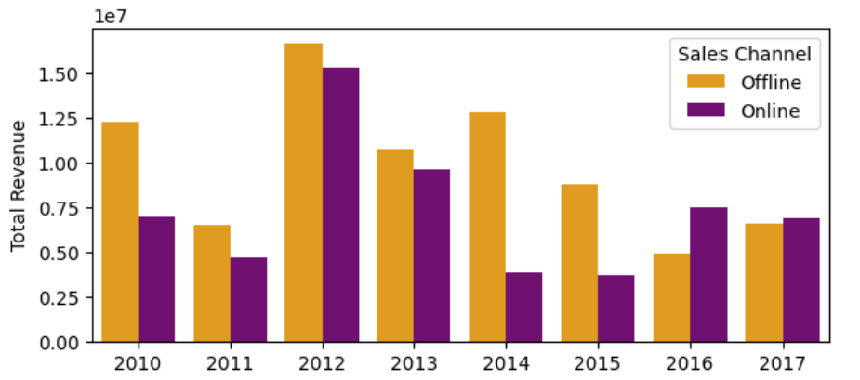
TOTAL YEARLY PROFIT BY SALES CHANNEL
TOTAL YEARLY SALES AND REVENUE BY SALES CHANNEL

Slide 5
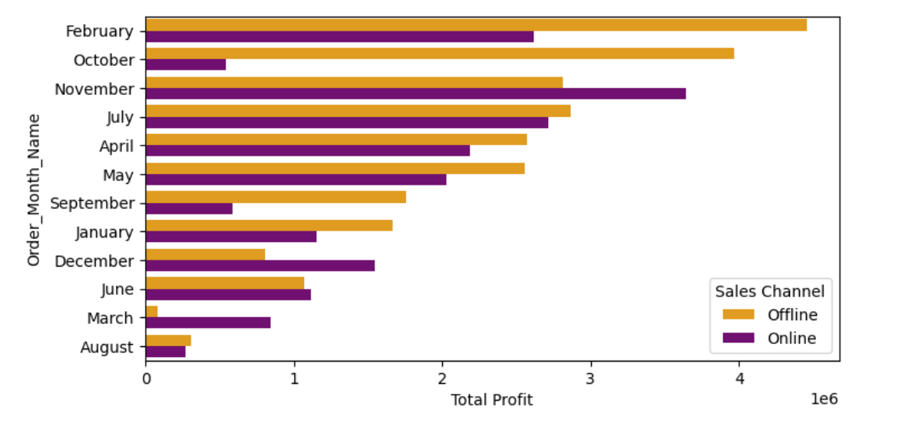
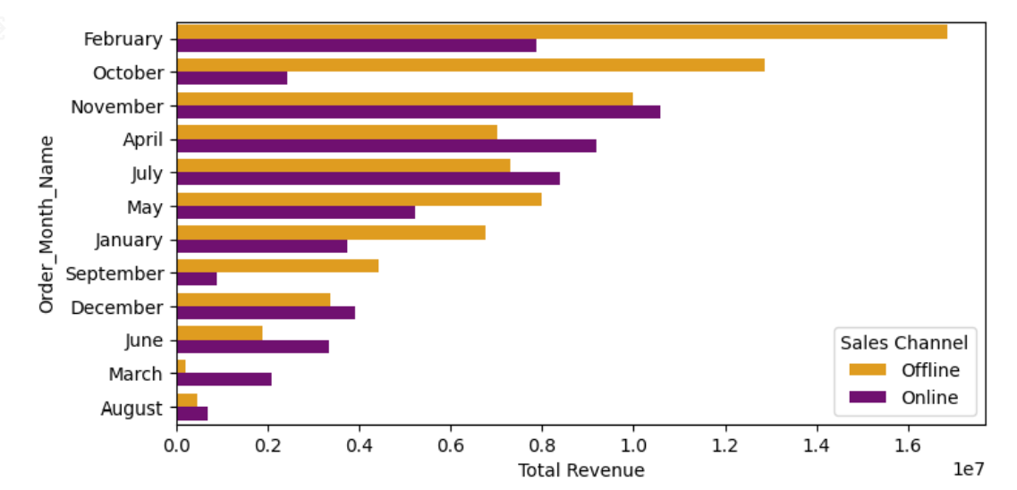
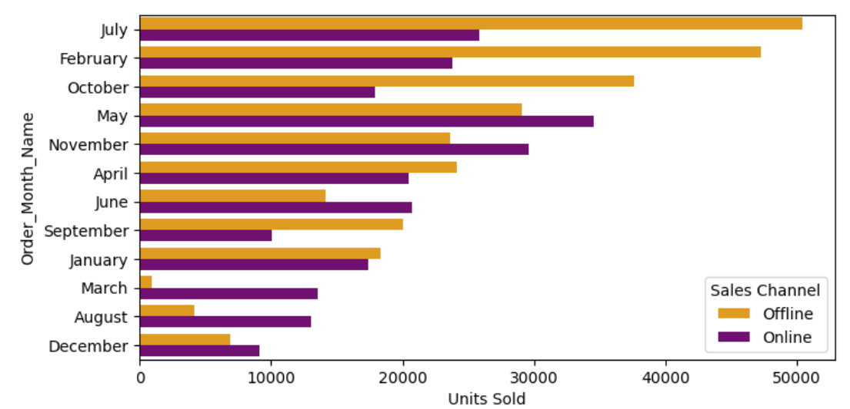
TOTAL MONTHLY PROFIT BY SALES CHANNELS
TOTAL MONTHLY SALES AND REVENUE BY SALES CHANNELS

Slide 6
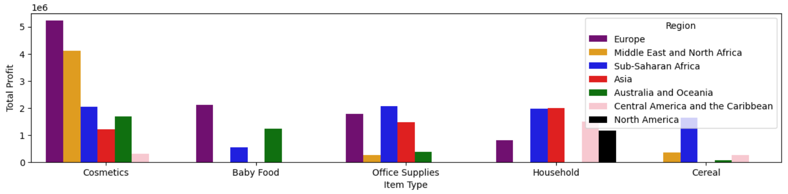
TOP 5 MOST PROFITABLE PRODUCT SEGMENTS AND THEIR REGION (2010-17)

Slide 7
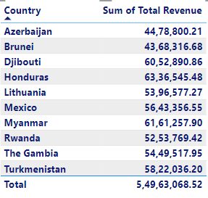
TOP 10 CUSTOMERS W.R.T REVENUE

Slide 8
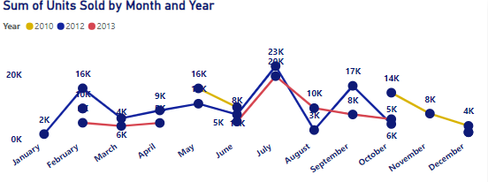
MONTHLY COMPARISON FOR HIGH SALES YEAR

Slide 9
CONCLUSION
Our highest revenue and profit year was in 2012, but we experienced a decline from 2014-2017.
Most of our profit, revenue, and sales come from offline channels.
The Sub-Saharan Africa region was the most profitable and revenue generated region, followed by Europe.
Cosmetics, Household, Office Supplies, Cereal, and Baby Food were our top 5 most profitable product segments.
Europe was the most profitable region for us, due to high sales of cosmetics, office supplies, and baby food.
February and November were the most profitable and revenue generated months.
Online channels performed well in June, December, and November.

Slide 10
RECOMMENDATIONS
We should find the reasons behind this decline after 2014 and take necessary steps in order to improve our Revenue, Sales and Profit.
We should focus on optimizing our offline channel as it contributes the most to our profit, revenue, and sales.
We should invest more in Sub-Saharan and European Region as it was our most revenue and profit generated regions.
We should promote and expand in cosmetics, office supplies and baby food especially in Europe in order to gain more profit.
We should give more discount offers, free home delivery and other offers to capture online market in the month of June, December and November.

Slide 11
THANK YOU

